Slide 1
Systematic errors in connectivity inferred from activity in strongly recurrent networks
Presenter: Yusen Zhu
Feb 27 2021

Slide 2
Reference
Das, Abhranil, and Ila R. Fiete. "Systematic errors in connectivity inferred from activity in strongly recurrent networks." Nature Neuroscience 23.10 (2020): 1286-1296.

Slide 3
Main conclusion
Inferring true neural connection in highly recurrent network is subject to systematic bias.

Slide 4
Simulation

Slide 5
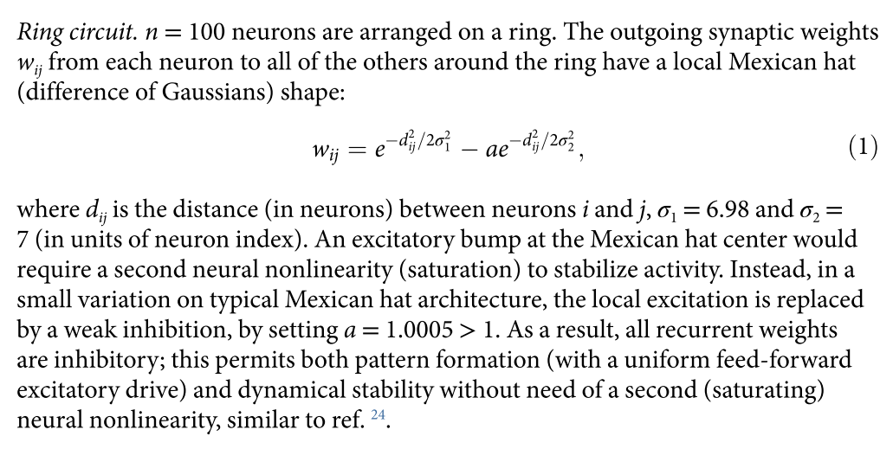
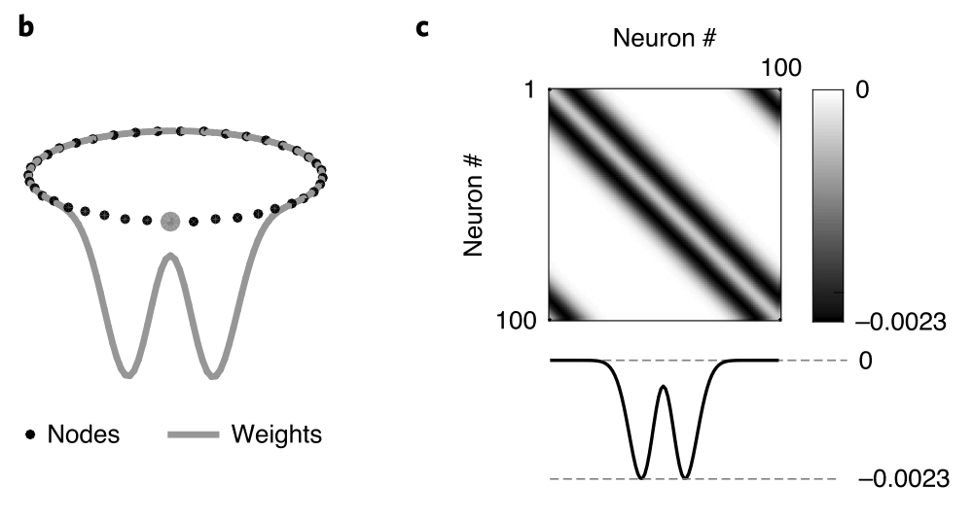
Model - Connection

Slide 6


Model – Spike generation
Noise or fixed input only
Spike generation employs various mechanisms: threshold, exponential Poisson, Ising

Slide 7
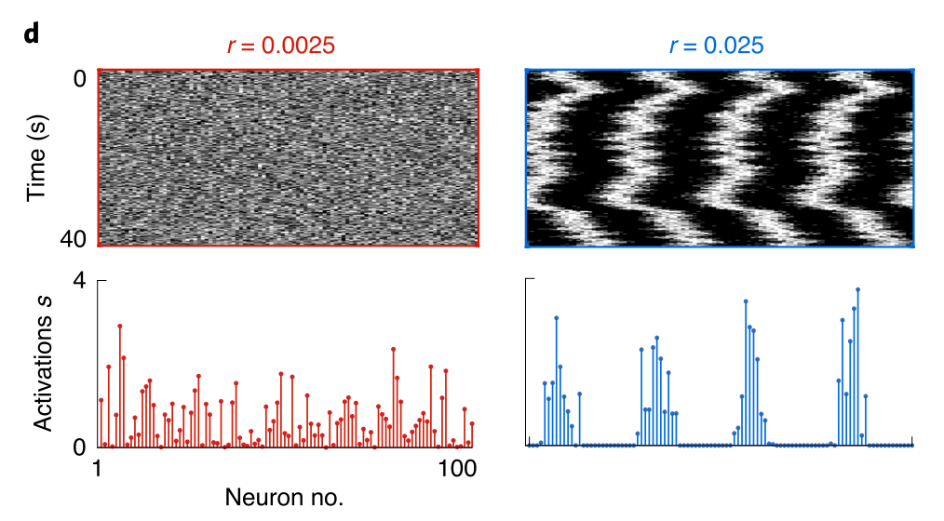
Example data

Slide 8
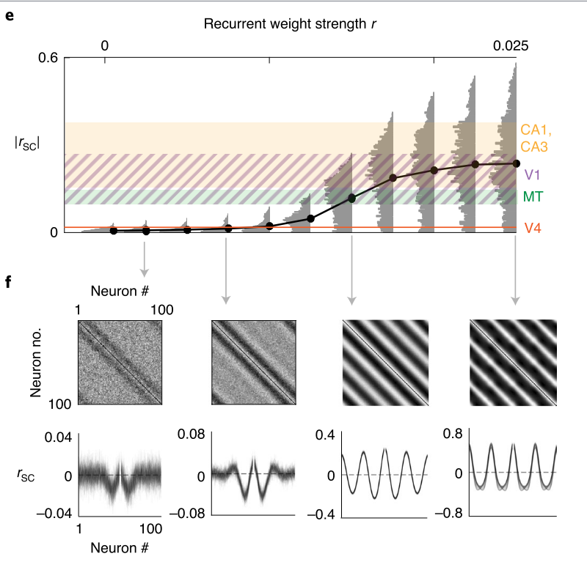
Result: Pattern formation

Slide 9
Main result – Inference error

Slide 10



Inference - GLM
Note that this is first used on data generated by the exact same mechanism

Slide 11
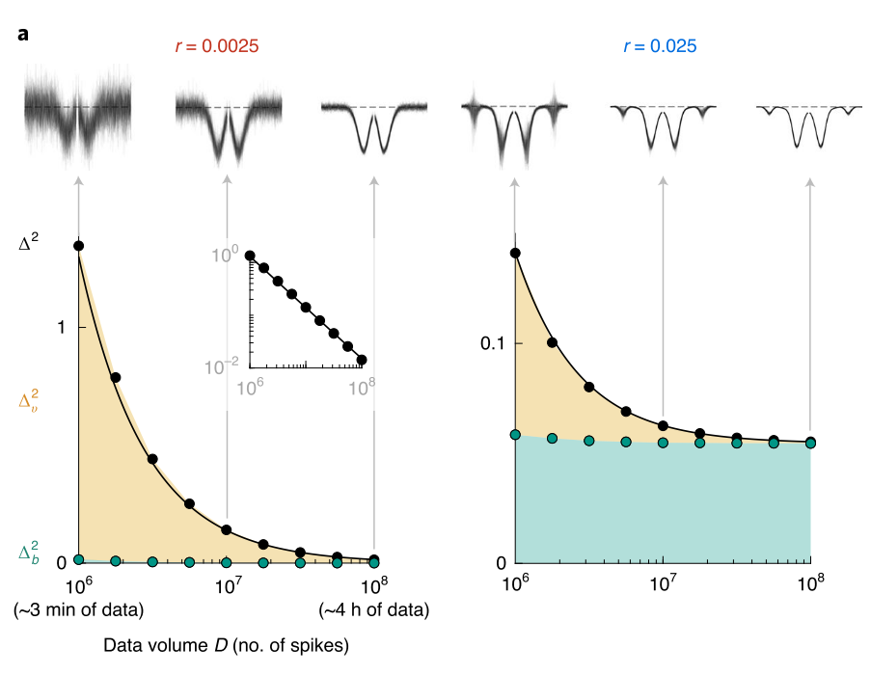
Inference result - GLM
In strongly recurrent network, systematic bias emerge due to the pattern formation
Increasing dataset size decrease variance error but not bias error

Slide 12
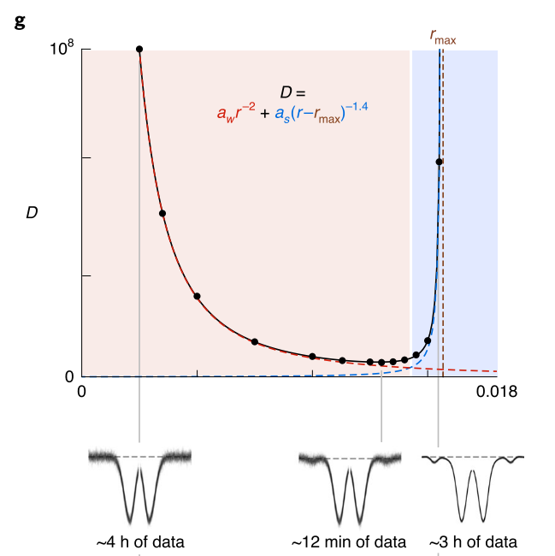
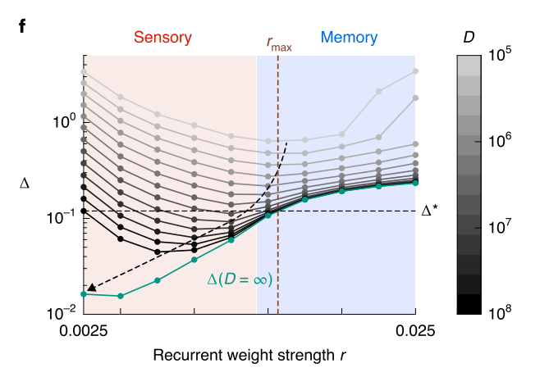

Slide 13
Support result: Other errors

Slide 14
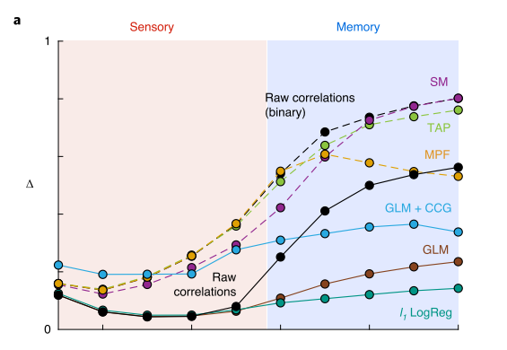
Model mismatch – Ising inference on GLM data
When model does not match this only adds more error

Slide 15
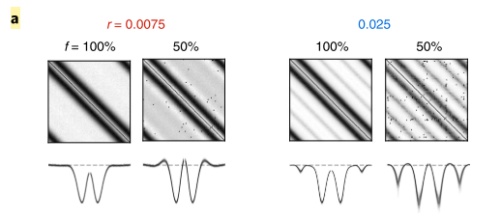
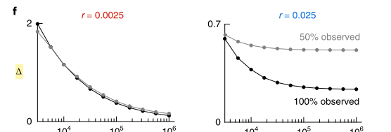
Missing data

Slide 16
Extension: different networks, CCG, l-1 norm

Slide 17
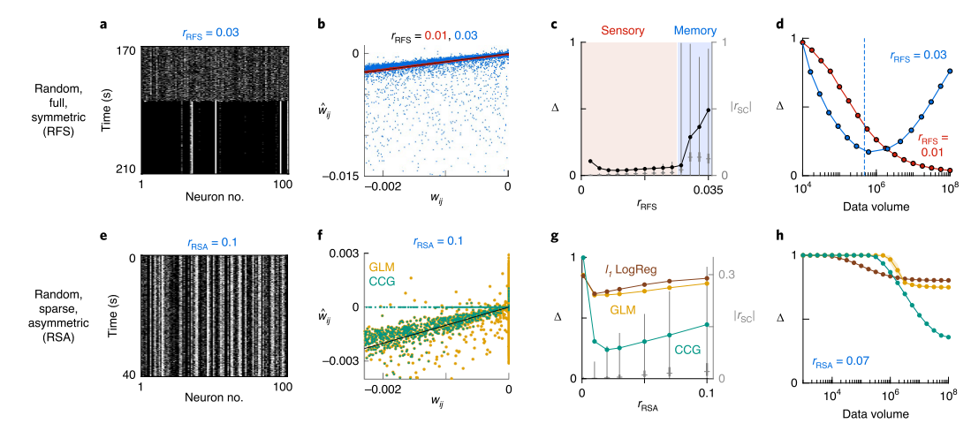
Extension to different models

Slide 18
Possible solution?

Slide 19
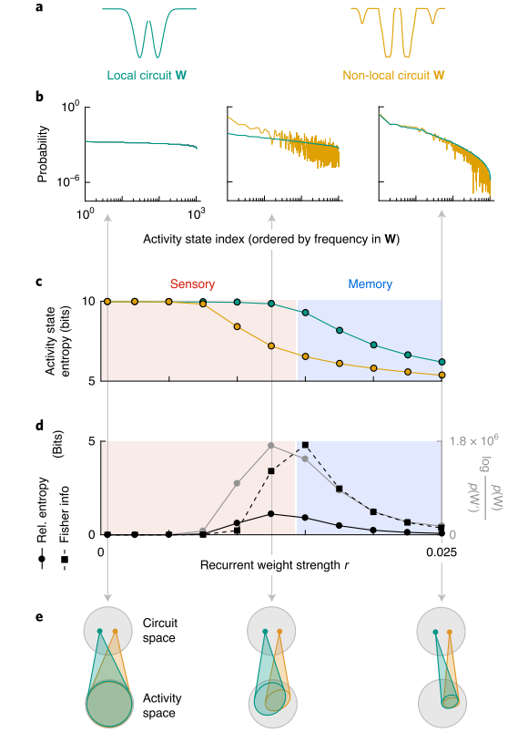
Non-invertible problem
It is impossible to distinguish local and non-local connection when they produce almost the same result

Slide 20
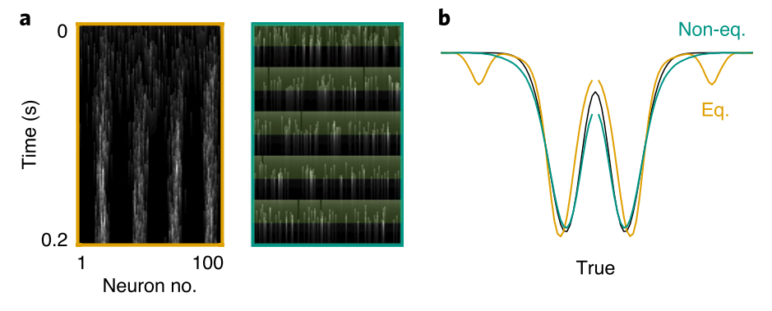
Possible solution: far from equilibrium data

Slide 21
Discussion

Slide 22
Thanks!

